Slide 1
Financial Abuse Safeguarding Conference
27th September 2016

Slide 2
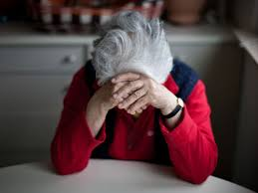
Adults at risk – A case study

Slide 3
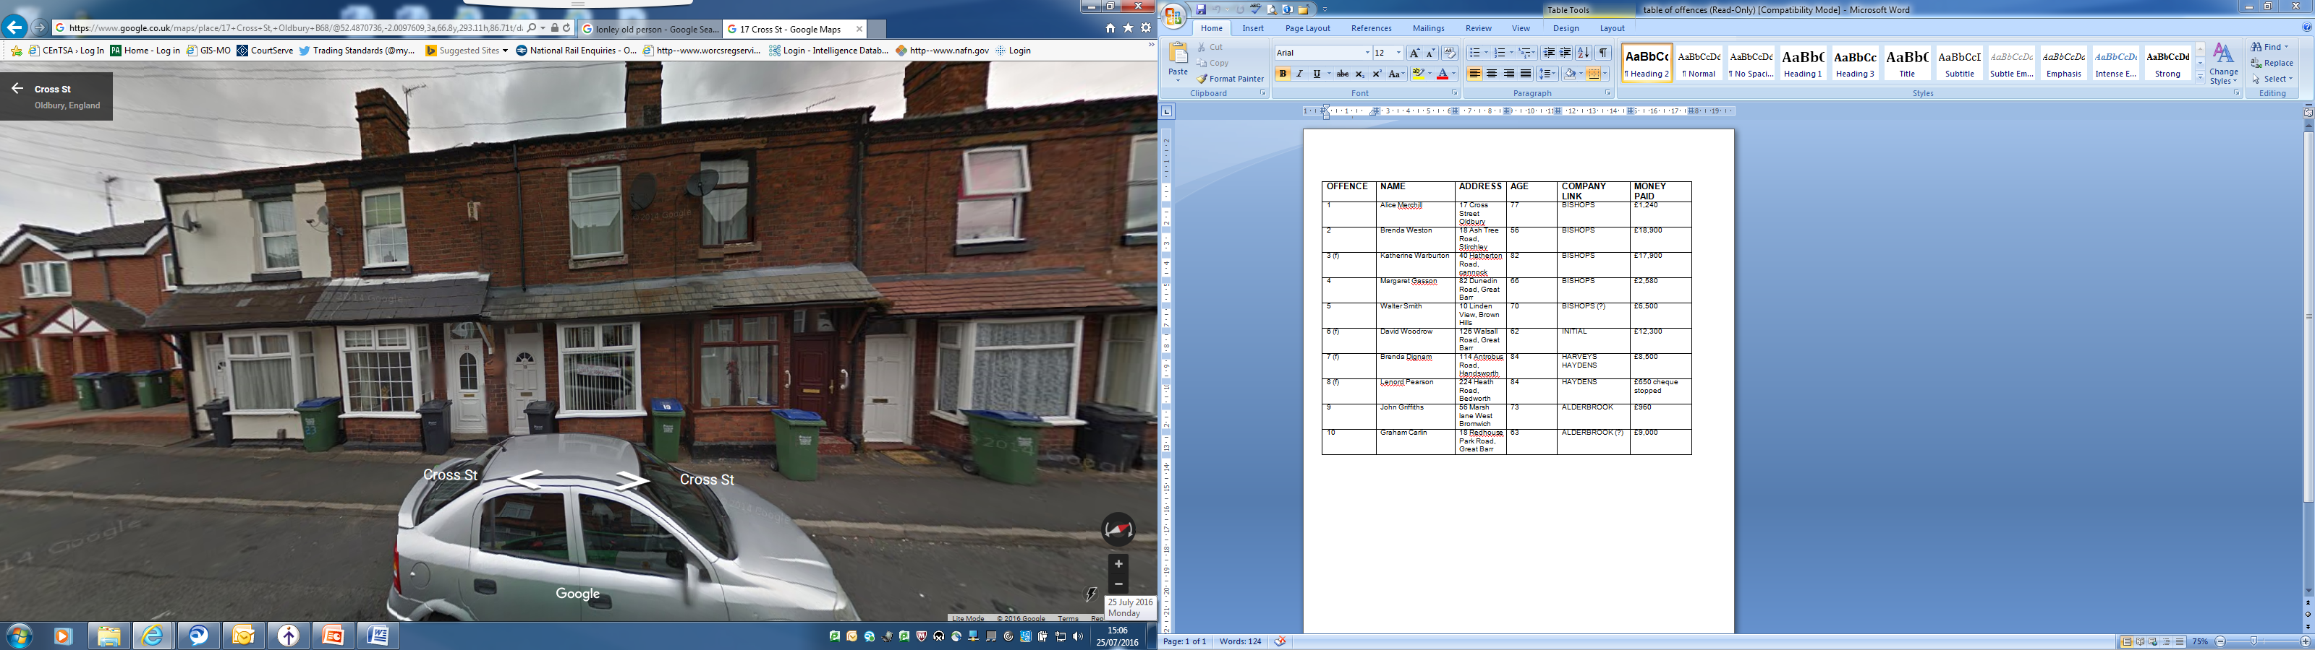
How it all started
Alice’s house

Slide 4
Alice aged 77 years & lived alone in Smethwick
Cold called by males who told her she had a problem with her roof
Neighbour saw 2 men on roof damaging flashing
Neighbour took photographs
Reported to Sandwell Trading Standards
Traders identified as Bishop’s Property Services from Birmingham
Traders named as “Frank” & “Dave”
Alice paid £1,240 to traders

Slide 5
What happened next?
Criminal investigation started
“Dave” identified as Steven Allen
Warrant executed & evidence seized
Phone analysis undertaken
Analysis identified other potential victims
Visits made to other potential victims

Slide 6
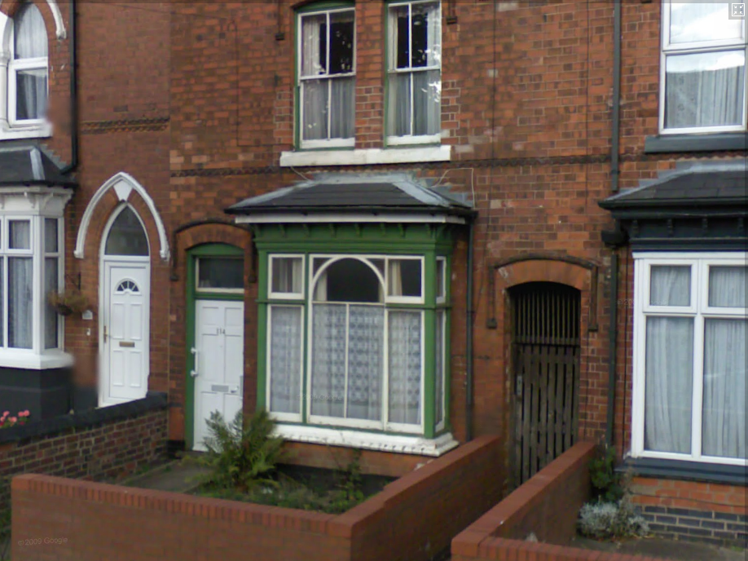
Brenda’s story

Slide 7
Brenda was in her late 80s
She’d lived in her house for nearly all of her life
She’d lived alone since the death of her husband 20 years ago
Paid out life savings of £19,000 to roofers
Invoices showed the same work carried out on more than one occasion
A survey found little work done, not necessary, very poor standard

Slide 8
Invoices in company names of Harvey’s and Hayden’s – both from Birmingham
Trader’s named as “Dave” & “Frank”
Mobile phone number on paperwork same as Bishop’s Property Services
Trader only stopped visiting when Brenda’s life savings had gone
Reported to Police – Written off as a Civil matter

Slide 9
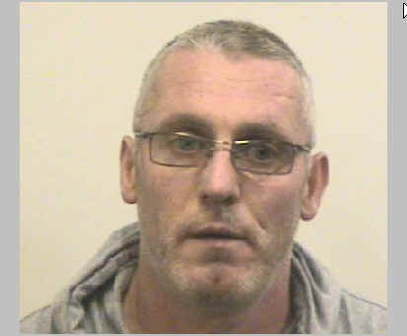
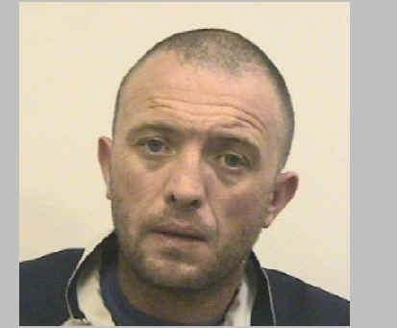
“Dave & Frank”
Steven Allen (40)
Vincent Smith (38)

Slide 10
Smith and Allen linked to the following building companies
Bishop’s Roofing Services
Alderbrook Roofing Services
Initial Building Services
Harvey’s
Haydens
A1 Roofing Elite

Slide 11
The investigation unearthed victims across the West Midlands and Warwickshire region.
Here are some of them.....

Slide 12
Brenda from Birmingham
Aged 56 years
Retired Nurse
Lived alone
Paid £18,900 to Bishop’s property services
Poor quality and non existent work to roof

Slide 13
Katherine from Cannock
Aged 82 years
Lived alone
Suffered from dementia
Thought she paid out about £2,000
Paid £17,900 to Bishop’s property services
Poor quality and non existent work to roof

Slide 14
Walter from Brownhills
Aged 70 years
Registered blind
Lived alone
Other significant health issues
Cold called by different roofers who told him he had a problem with his roof
Paid £6,500 to Bishop’s property services
Poor quality and non existent work to roof

Slide 15
Graham from Great Barr
Aged 63 years
Retired professional
Lived alone after caring for his mother
Paid £9,000 to Alderbrook Roofing Services
Poor quality and non existent work to roof
Subsequent victim of other criminal scams

Slide 16
The Allen/Smith Case
Both on benefits, Smith had access to a Motability vehicle
Neither had ever had a “proper” job and neither had a tax record
Identified victims through Yellow pages advert and by cold calling
Earned at least £150,000 in two years carrying out bogus property repairs

Slide 17
Both linked to a network of similar offenders
Joint investigation by Police and Trading Standards
Evidence relating to 9 victims (all elderly) brought to court
Other victims identified who were either too ill to give evidence or who had passed away

Slide 18
Outcome
Allen received 3 ½ years and Smith 5 years imprisonment
Most importantly – vulnerable and elderly people protected

Slide 19
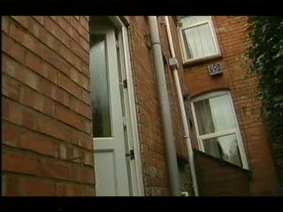

Slide 20
Why do we need to raise awareness?
The victims of Doorstep Crime tend to be
Vulnerable
Elderly
Isolated
Lonely
Trusting
Little or no immediate support network

Slide 21
If we don’t do something to protect the most at risk, who will?

Slide 22
“What will you take away from this presentation?”

