Slide 1
Preventing Financial Abuse
Rachel Gee
Financial Crime Manager

Slide 2
1/
The Coventry: Background
2/
Protecting our members
3/
Vulnerable Customer Project: Objectives
4/
Exploitation of Vulnerable People
5/
Staff Vigilance
6/
Account Monitoring
7/
Challenges and Risk
8/
Working Together
9/
Case Studies
10/
Questions

Slide 3
1/ The Coventry: Background

Slide 4
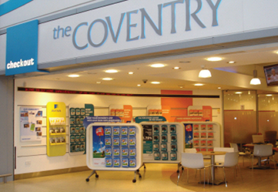
1/ The Coventry: Background
3rd largest building society in UK
Approximately 2,100 employees
£34bn group assets at Dec 2015
70 branches; 19 agencies
Call centre and on-line services. National network of mortgage intermediaries
1.7 million customers
At the Coventry we put Members first in everything we do

Slide 5
2/ Protecting our members

Slide 6
2/ Protecting our members
Financial abuse is a serious issue that has increased in prominence in recent years.
Scope of definition of customers who may be vulnerable to financial abuse includes:
Someone who has mental capacity to make decisions but, due to individual circumstances (e.g. physical disability) may require some assistance;
Someone who has limited or no mental capacity to make decisions and requires assistance or reasonable adjustments;
Someone who has limited capacity to make decisions, and/or may be at risk of succumbing to scams or other financial abuse due to financial hardship;
Minors.
Many customers may be at risk from financial abuse

Slide 7
3/ Vulnerable Customer Project: Objectives

Slide 8
3/ Objectives of Vulnerable Customer Project
Develop a Society-wide policy to ensure the fair and consistent treatment of customers at risk of financial abuse
Clearly documented procedures readily available to all staff
Improved awareness amongst customer-facing and support staff of factors which may make a customer vulnerable
Quick escalation, and prompt action, where concerns exist
Better understanding and application of appropriate methods for third parties to transact on a customer’s account
Improved awareness of scams (amongst staff and customers)
Review of our account monitoring arrangements
Comply fully with regulatory expectations
Avoidance of discrimination
Financial inclusion
Our overriding aim is to ensure all customers are treated fairly and equally

Slide 9
4/ Exploitation of Vulnerable People

Slide 10
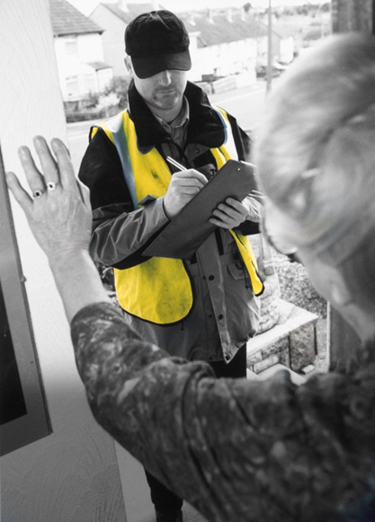
4/ Exploitation of Vulnerable People
Investment in worthless schemes
“Phishing” , “Vishing” & “Smishing”
Dating and Romance Scams
Foreign lotteries
Rogue traders / doorstep criminals
Financial abuse by a relative
Abuse by an attorney, or other third party
Money mules
Borrowing and Saving customers are equally at risk

Slide 11
5/ Staff Vigilance

Slide 12
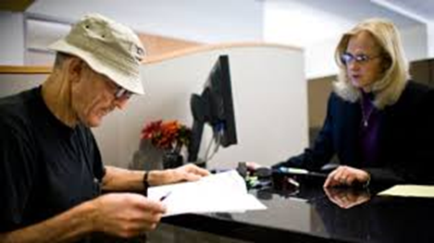
5/ Staff Vigilance
Our employees are our first line of defence:
Know your Customers
Training and awareness raising
Tactful questioning about the purpose of a transaction
Immediate escalation

Slide 13
6/ Account monitoring

Slide 14
6/ Account Monitoring
A suite of monitoring controls in place:
Large and/or unexplained increase in ATM withdrawals
Sudden change in account transaction profile
Large payments to 3rd parties (cheque, electronic transfers, all channels)
Pro-active telephone contact with customers
A combination of alert staff and pro-active monitoring is needed

Slide 15
7/ Challenges and Risks

Slide 16
7/ Challenges and Risks
Achieving the right balance between protecting customers and not being intrusive
Assessing vulnerability – “we’re not doctors”
De-mystifying a difficult subject
E.g. How does Power of Attorney work?
Ensuring a consistent response
Who is liable in the event of loss?
Complaint handling
What if the customer doesn’t remember the transaction?
Is it definitely fraudulent?
Improving customer awareness
Keeping up with the fraudsters

Slide 17
8/ Working Together

Slide 18
8/ Working Together

Slide 19
9/ Case Studies

Slide 20
9/ Case Studies
Mr A – customer’s elderly grandmother who looked after him all his life passed away leaving a large inheritance. Mr A proceeds to withdraw significant funds from his account in cash on a daily basis. It is feared that he may be being taken advantage of and does not understand the value of money having never had to look after himself financially before, however, there is no formal help available for him as he has capacity.
Mrs B – customer was contacted by “the fraud department” of her bank and informed that her money was at risk due to internal staff fraud. Mrs F was instructed to transfer money to an alternative account that had been set up for her whilst this was investigated and to not tell bank staff, if asked, why she was withdrawing the money as they may be in on the scam.
Mr C – builder targets elderly customer (Mr C) stating that in order to carry out required roofing repairs that he needed to pay an upfront deposit for the specialist piece of machinery the company would need to rent (£50k). Mr A is told by the builder that he will re-coup this money back after the work is completed.
Mrs D – elderly customer applied for an equity release mortgage to raise funds to pay tax on winnings from a foreign lottery. The purpose of the loan was not disclosed.
Mr E – daughter of elderly customer (Mr E) is added to Mr B’s sole account (at his request) to help him with his finances when he moved into a care home. She had a serious gambling addiction, and later withdrew most of the funds in the account.

Slide 21
Any Questions?
What will you take away from this presentation?

